Slide 1
Internet basics
What is the Internet?

Slide 2
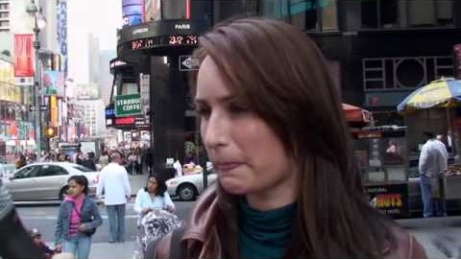
Important Terms
Internet, Web Browser, Search Engine. What does it all mean?

Slide 3
What is the internet?
A global network of billions of computers and other electronic devices
When a computer is “online”, that means it is connected to the internet
The internet services includes: e-mail, instant messaging, multiplayer gaming, social media, and FTP (peer-to-peer file sharing)
The internet connects computers by wires – ethernet cables, phone lines, and fiber optic wiring on the ocean floor!

Slide 4
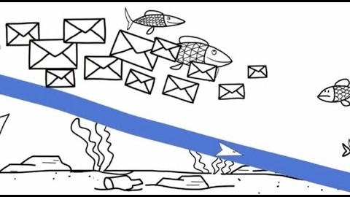
How the internet works

Slide 5
What is the web?
A collection of websites you can access through the internet
People often use the words “the internet” and “the web” interchangeably. Is there a difference?
WWW is the linked documents/webpages that can be viewed in a browser.

Slide 6
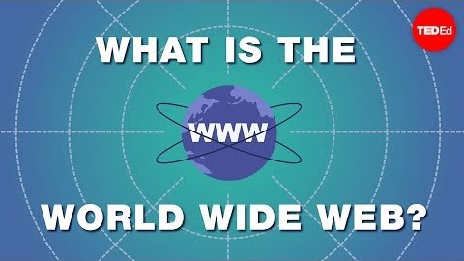
WWW

Slide 7
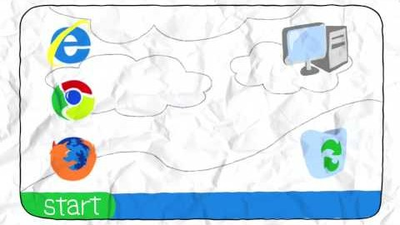
What is a Browser
Software that allows you to find and view webpages on the internet
Translates the codes on webpages so we can see the information
Chrome, Firefox, Safari, Edge

Slide 8
Website vs. webpage
Website
Webpage
Collection of webpages that belong to one domain (owner)
A hypertext document (which can include images, videos, charts, etc) viewable through a web browser.
Example: www.cincinnatizoo.org is a website for the Cincinnati Zoo. “Plan Your Visit” is a webpage on the website.

Slide 9
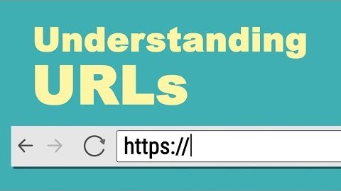
Web Addresses
Identifying address for a webpage, like a street address
A specific webpage on the internet
AKA URL (Uniform Resource Locator)

Slide 10
What is a Search Engine?
The program that helps you find webpages on the internet.
Search engines do not search the whole web, but only an index (keywords) on the web.
Examples: Google, Yahoo, Bing, Excite

Slide 11
Searching the Web
Search Engines
Uses keywords to locate webpages
Google, Yahoo!, Bing

Slide 12
Reading Search Results
Web Address
Title
Snippet

Slide 13
Top-level domain
.com Commercial
.edu Educational
.gov US Government
.org Non-profit Organization
.net Networking Providers
.mil US Military
.int Organization

Slide 14
Understanding Web Addresses
Have I heard of the domain?
nytimes.com, somegoodnews.com
Domain type
.com, .edu, .gov, .org, etc
Symbols or names respresenting a personal page
%, ~, dchen, member, user
Is domain from a personal page hosting website?
Homestead.com, Geocities.com, Tripod.com
Does the address you what kind of file it is?
pdf, xls, jpg

Slide 15
Searching Tips
Exclusion (-)
Excludes words
Inclusion (+)
Makes sure the word it precedes is used exactly as entered
Similar Words (~)
Includes similar words
Multiple Words (OR)
Includes one, the other, or both words
Number Range (..)
Include a range of numbers
Exact Phrase (“ “)
Include only exact phrase

Slide 16
Resources
https://edu.gcfglobal.org/en/internetbasics/what-is-the-internet/1/
https://webfoundation.org/about/sir-tim-berners-lee/

