Slide 1
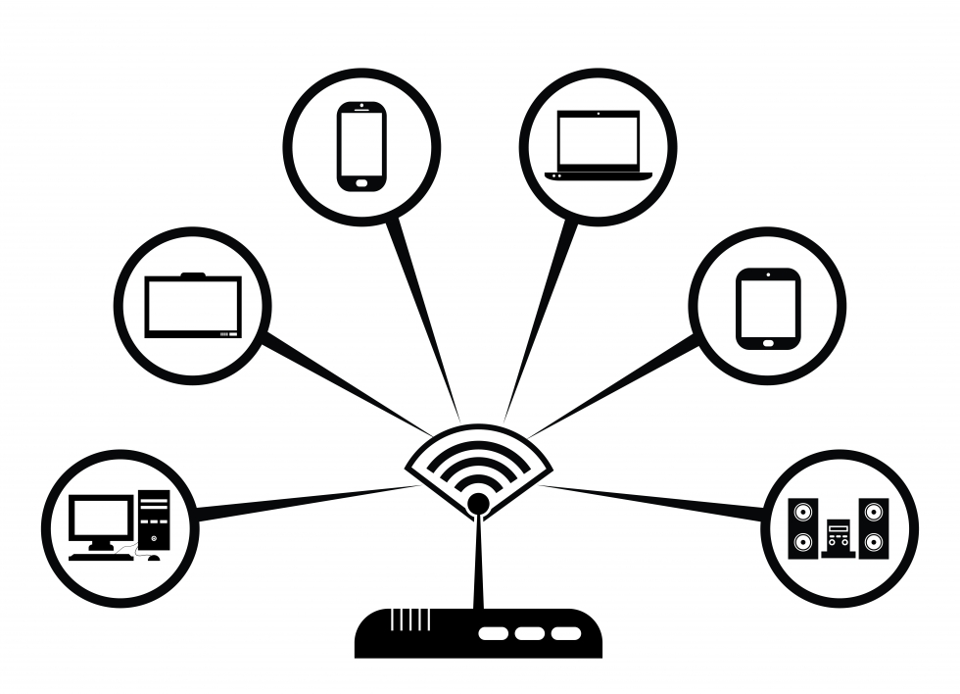
Connecting to the internet

Slide 2
Creating a Home Network
Click to watch the video below about connecting to the Internet
VIDEO: Connecting to the Internet

Slide 3
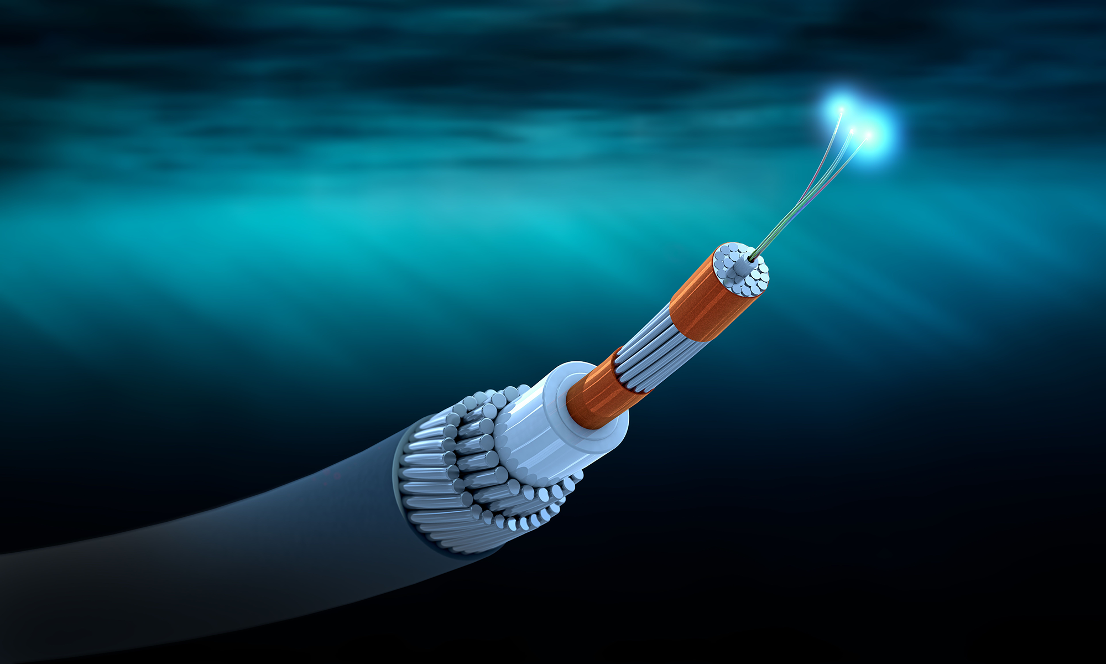
Types of internet service
Dial Up: Slowest type of connection, uses your phone lines
Will not be able to use landline phone when connected
DSL: Broadband connection, faster than dial up. Connect via phone line, but can use landline phone at same time
Cable: Broadband connection that uses cable TV. coax cable. Faster than DSL, only available where cable TV is available
Fiber Optic: Fastest connection. Most expensive. May not be available in your area. Connections use a fiber optic cable.
Cellular (4G & 5G): Wireless connection for phones and mobile devices. Limited amount of data on some plans

Slide 4
Internet Service Provider (ISP)
Companies that provide internet connections
Varying speeds – usually determines monthly cost
Email and social networking require slower connection than downloading music or streaming videos
AT&T, CenturyLink, Spectrum, EarthLink

Slide 5
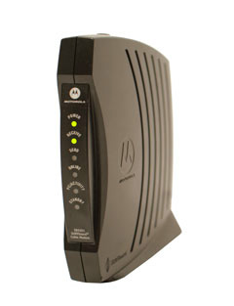
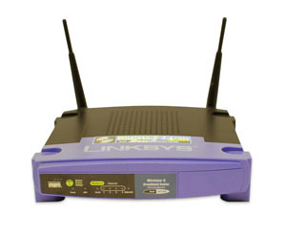
Needed Hardware
Modem
Hardware that connects your computer or network to the internet through your ISP
Router
Hardware that connects several computers or devices to a single internet connection
Needed for a home network
Wireless network known as Wi-Fi

Slide 6
Resources
https://edu.gcfglobal.org/en/internetbasics/connecting-to-the-internet/1/

